Slide 1
Design and Manipulation
Adding Columns to Support New Relations
Connecting Tables to Support Joins
Using FK-PK Relations and Synonyms

Slide 2
Recap of Join Types
Inner
Operation: exclusive, most common
Purpose: Include only matching rows from tables on both sides of join command.
Left / Right “outer”
Operation: inclusive matching
Purpose: Include all from inclusive side (left or right), and only the matching rows from other side.
Inner
Left
Right

Slide 3
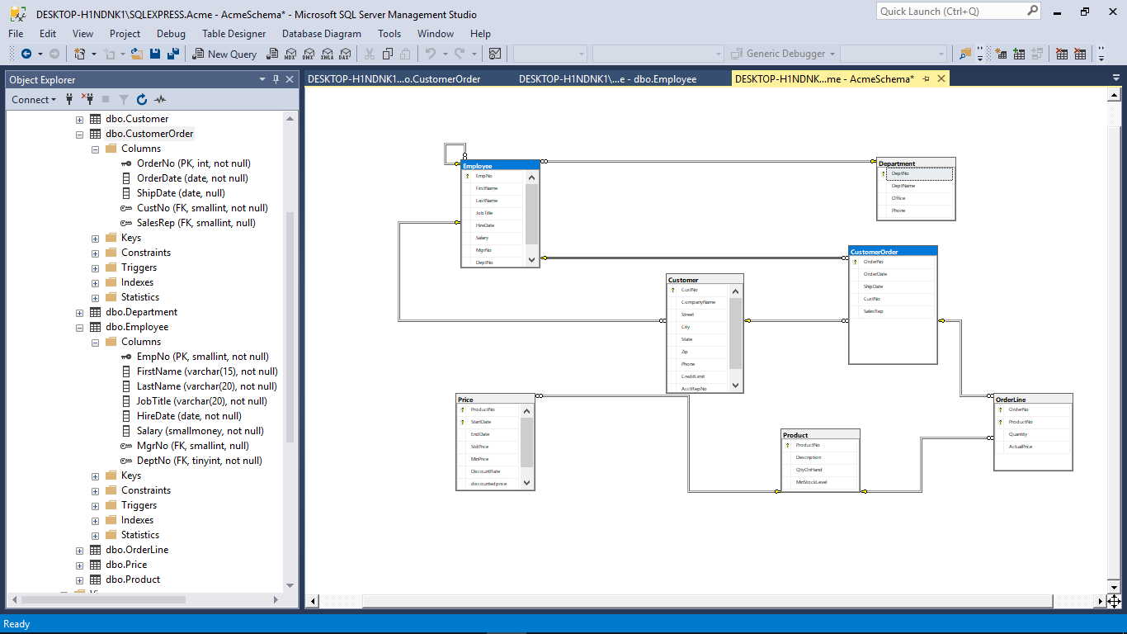
Acme
Let’s add a link between Employee and Customer Order
6 Table Database:
Employee
Department
Customer
Customer Order
Product
Price (table)
Why: If want to track Orders by Sales Rep instead of just by Customer and then backing out to Employee

Slide 4
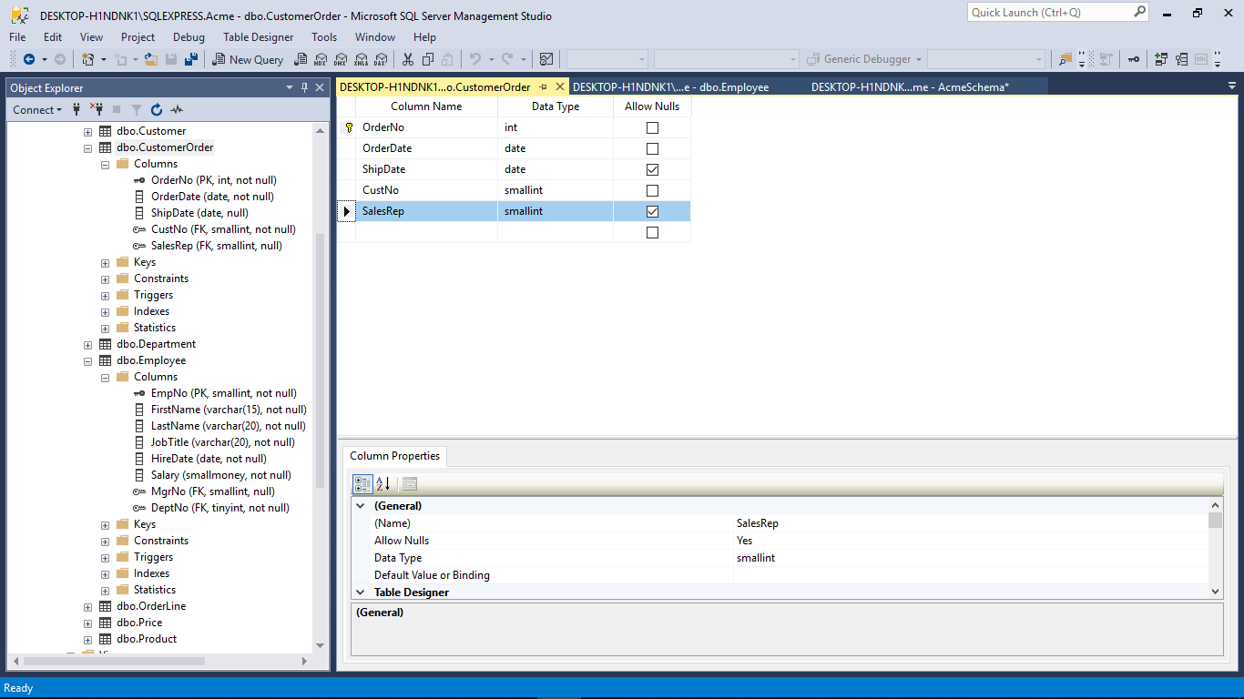
Add a column to use as FK
Make sure datatype matches the PK

Slide 5
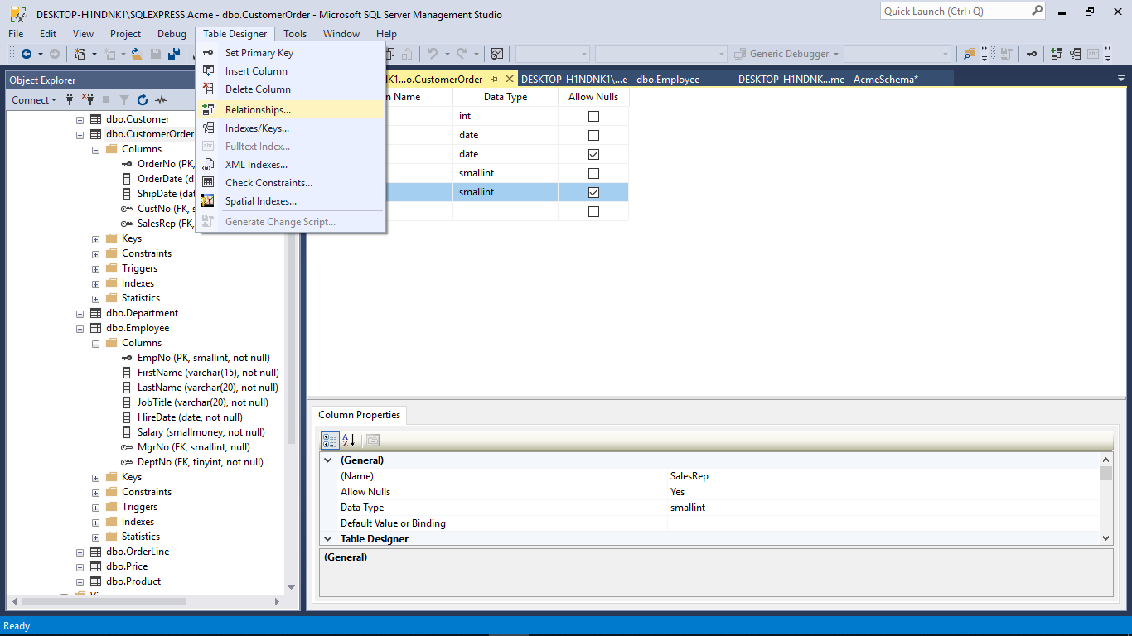
Create the relation

Slide 6
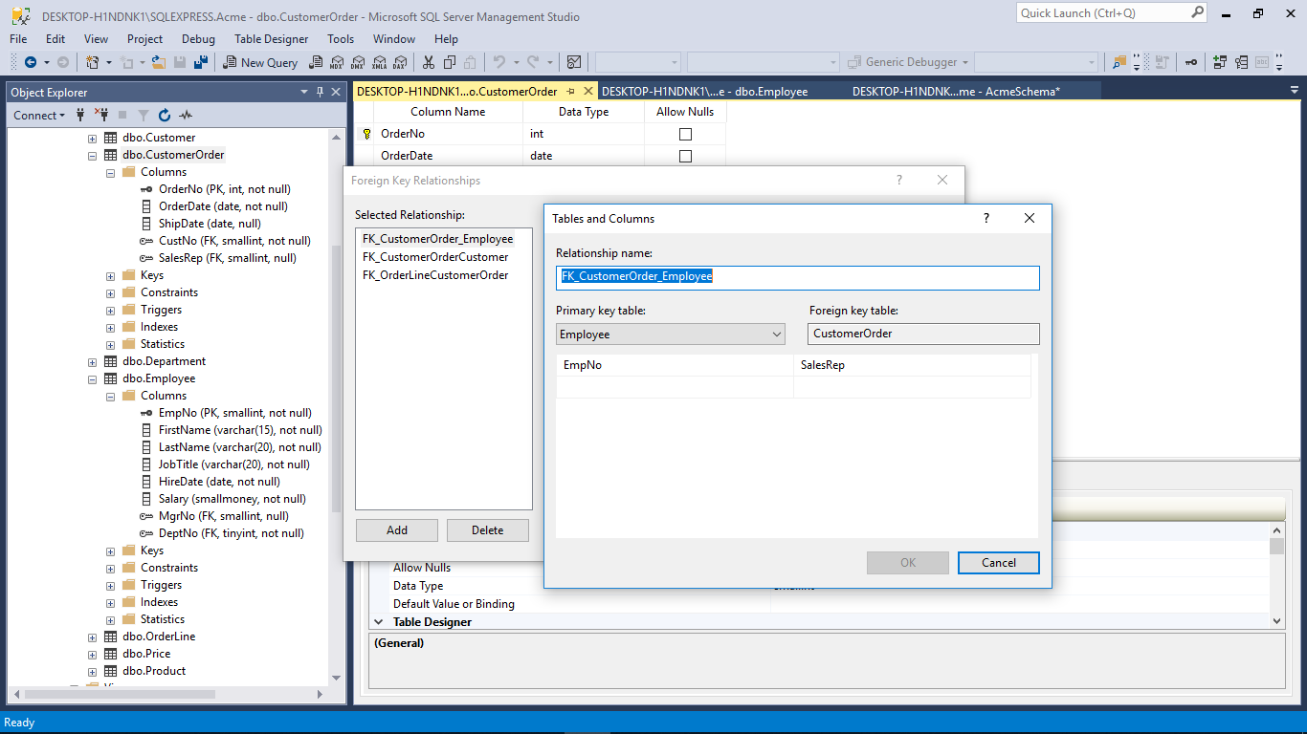

Slide 7
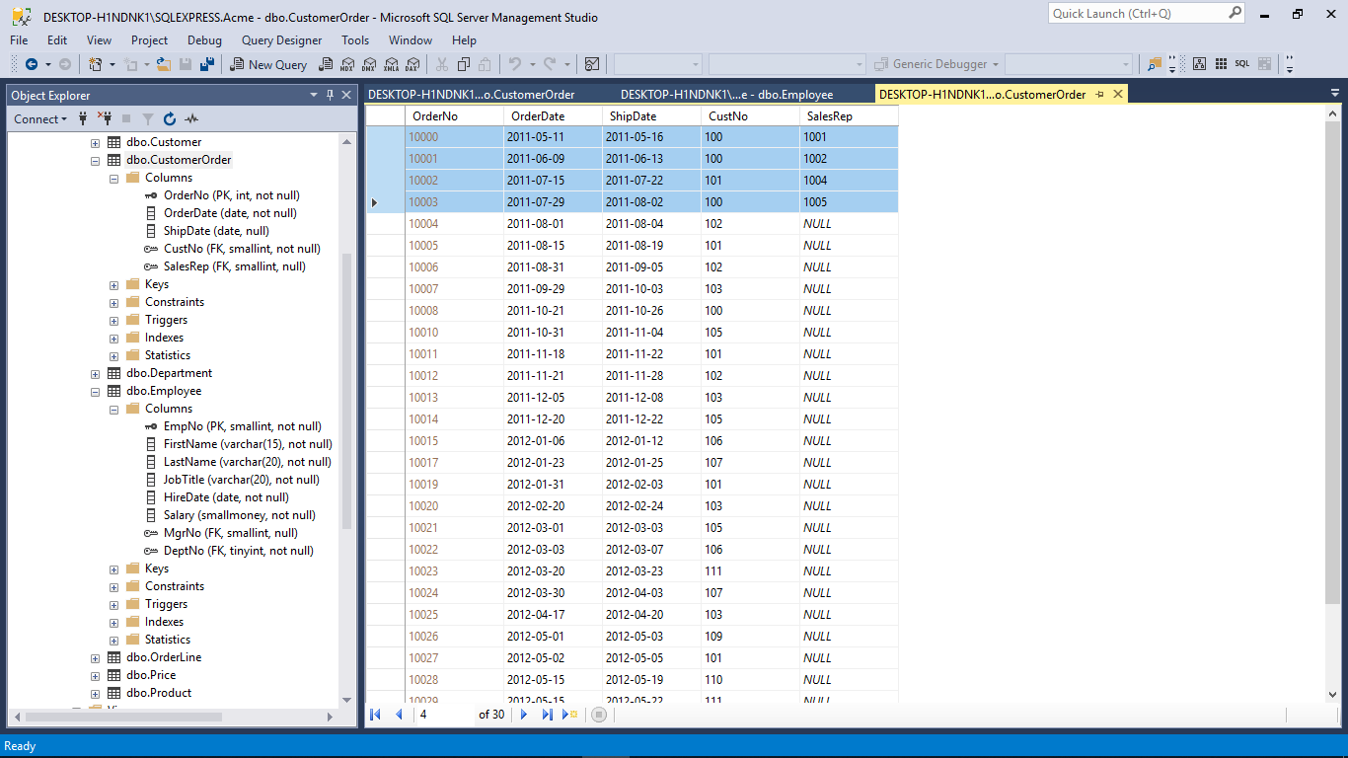
Add some Sales Reps

Slide 8
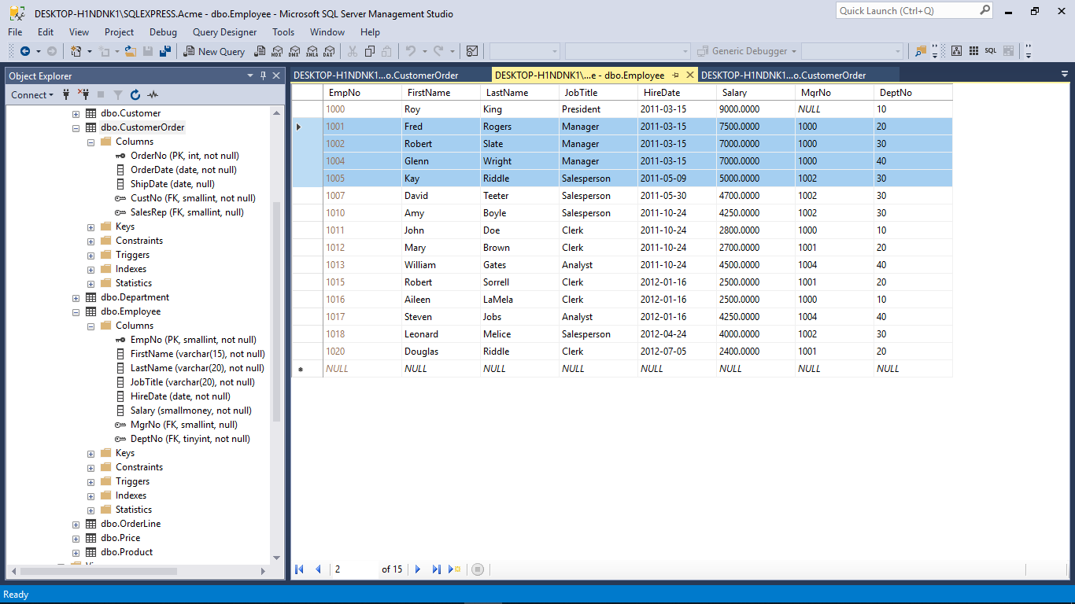
Notice that I made sure that there were valid EmpNo to choose from

Slide 9
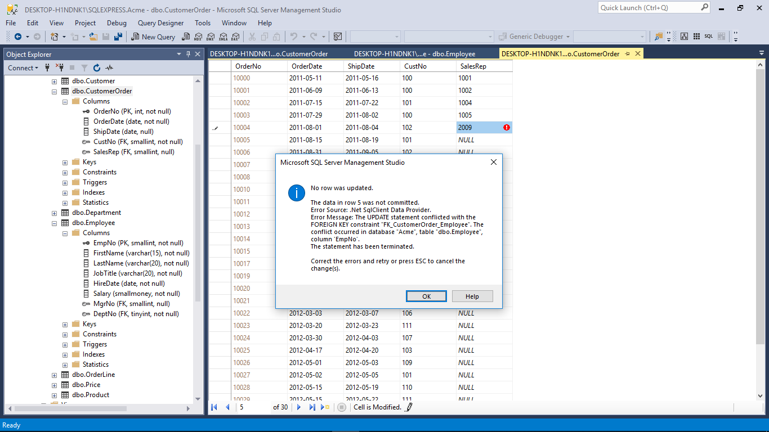
There is no EmpNo 2009:
Constraint (CN) violation
FK-PK violation
(data dependency)

Slide 10
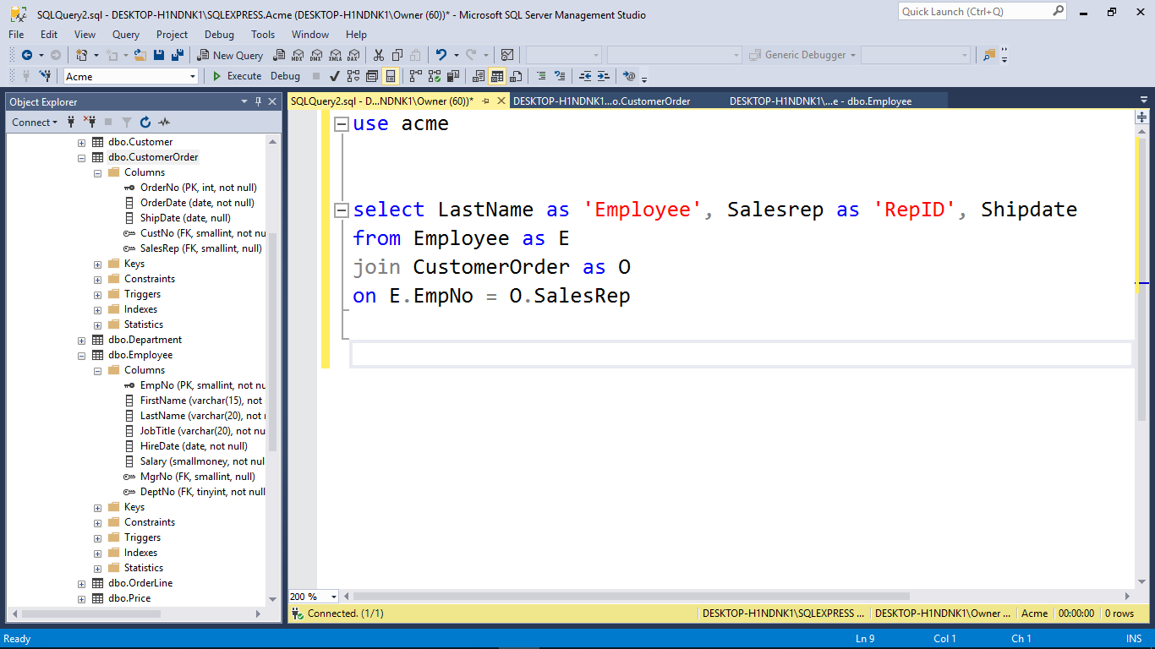
Let’s say I want to find all employees
that have been assigned Sales Rep numbers
to the order shipping dates.

Slide 11
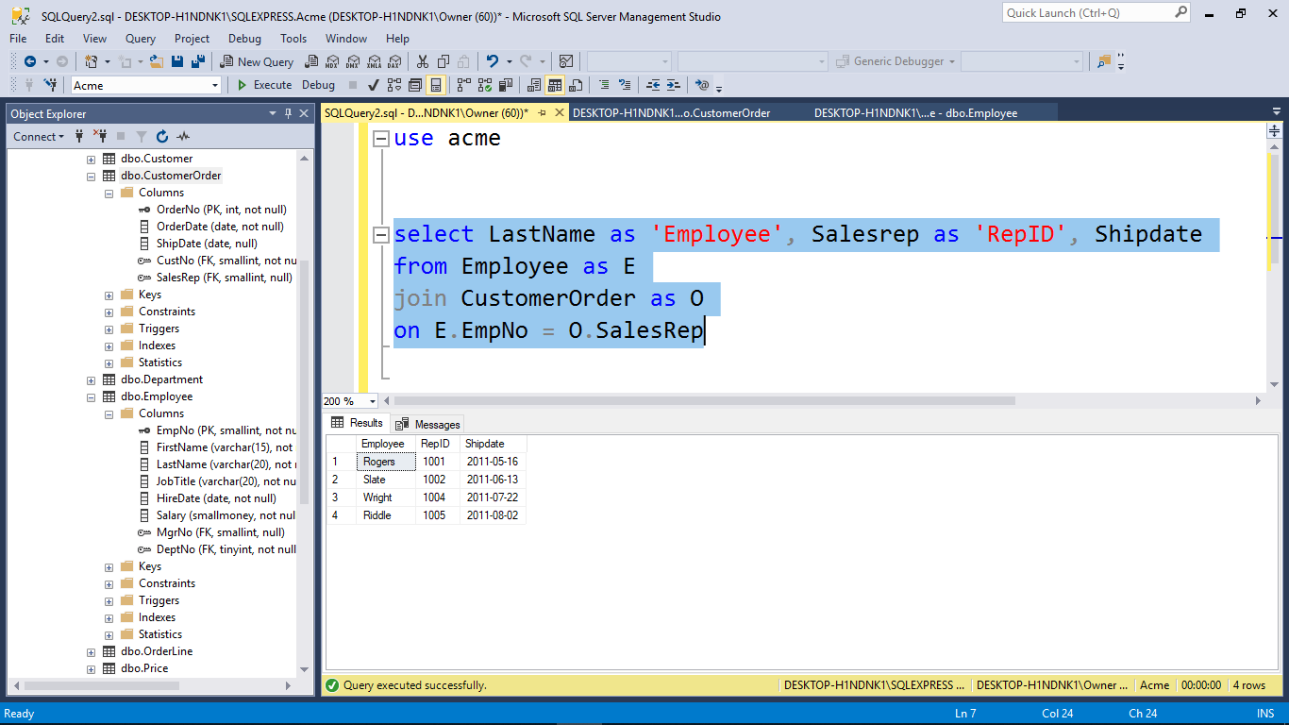
Join – meaning, scan these two tables for the rows that meet my question

Slide 12
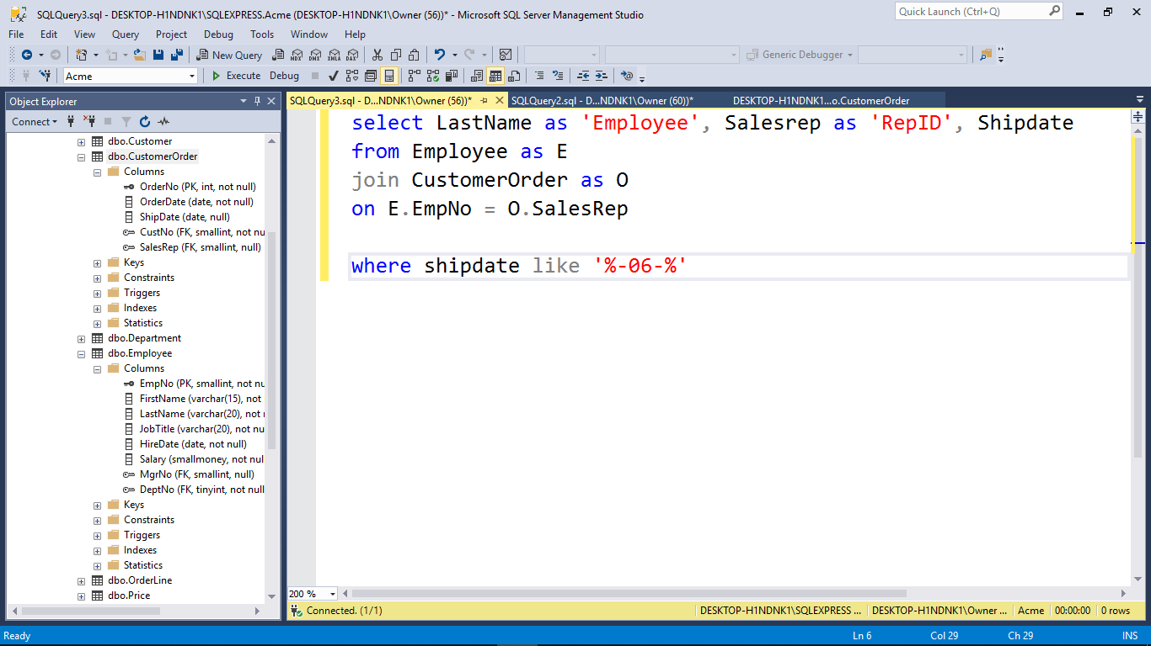
Let us dial that in,
We want to know what sales reps have been assigned to orders for the June sales cycle,
by Rep number and Last Name

Slide 13
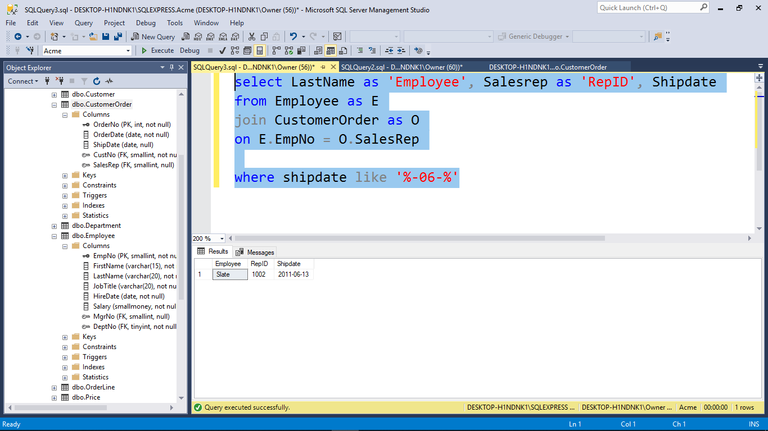

Slide 14
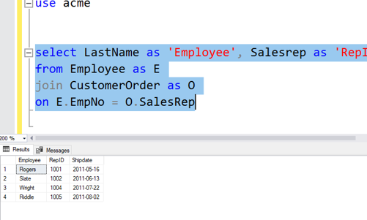
Compare

Slide 15
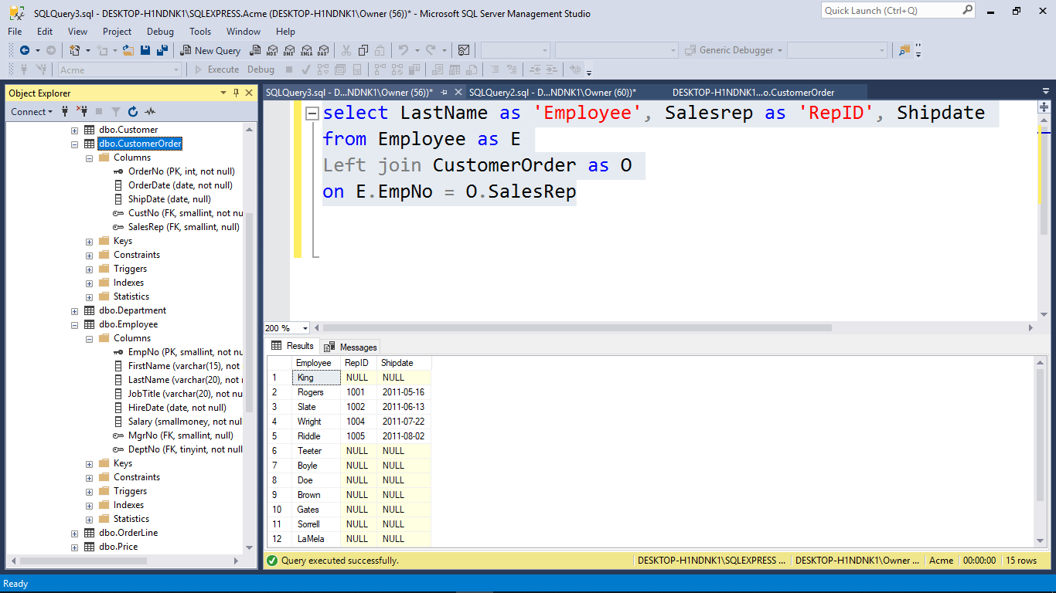
Give me all Last Names from Employee table and
match the rows that have Sales Reps and Ship dates assigned from Customer Order table

Slide 16
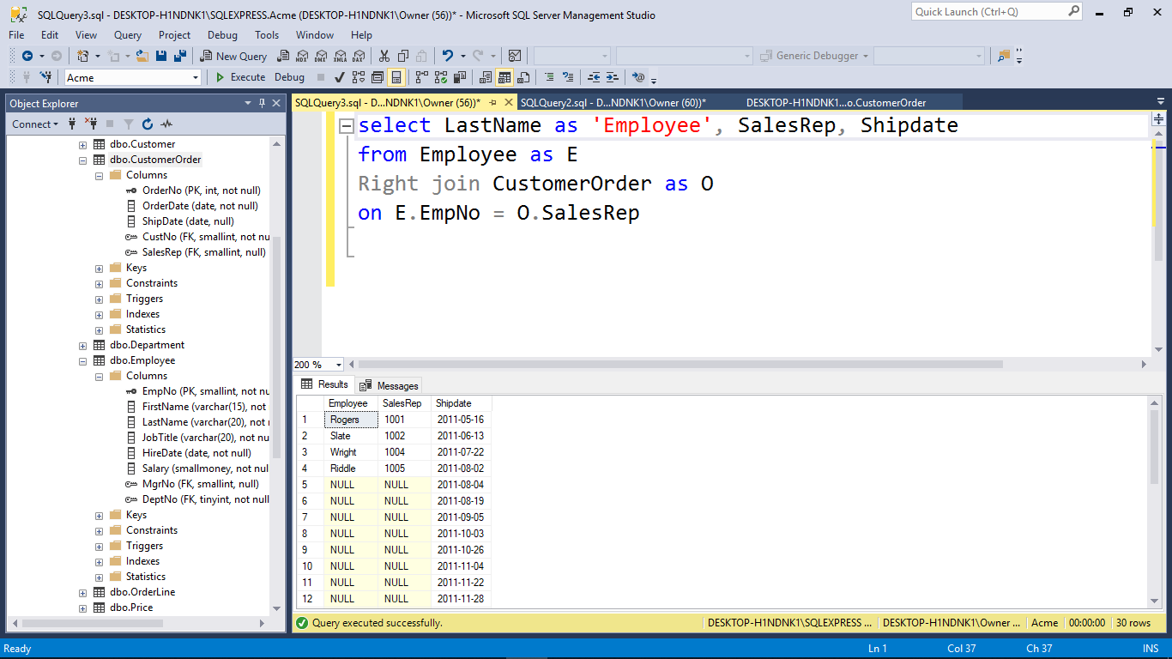
What’s going on here?
Remember I only added 4 rows of Sales Rep data.

Slide 18
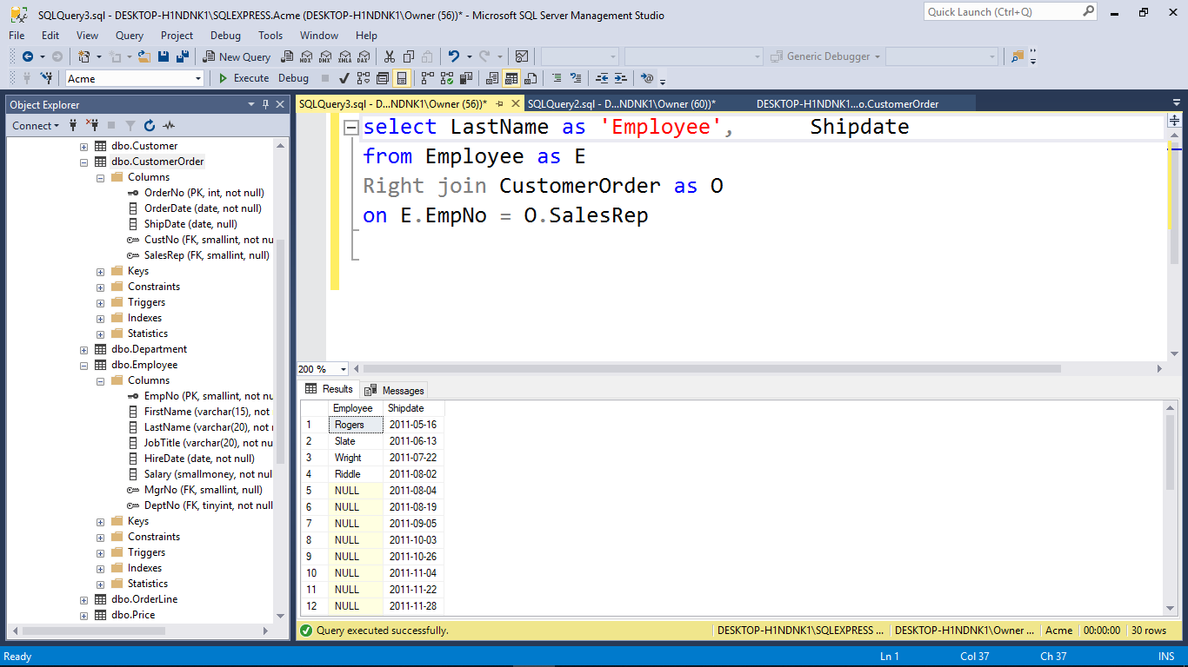
Let’s get rid of Sales Rep column
in our result panel
to make it less confusing
Give me all Ship dates from Customer Order table and only those Employees who have been assigned
By last name (from employee table)

Slide 19
Back to this output

Slide 20
We could use ‘isnull’ operator
select lastname, isnull(convert(varchar(12), salesrepno), 'not assigned') as 'RepID', isnull(convert(varchar(12), shipdate), 'not applied') as 'Ship Date'
from employee as E
Left join customerorder as O
on e.empno = o.SalesRepNo

Slide 21
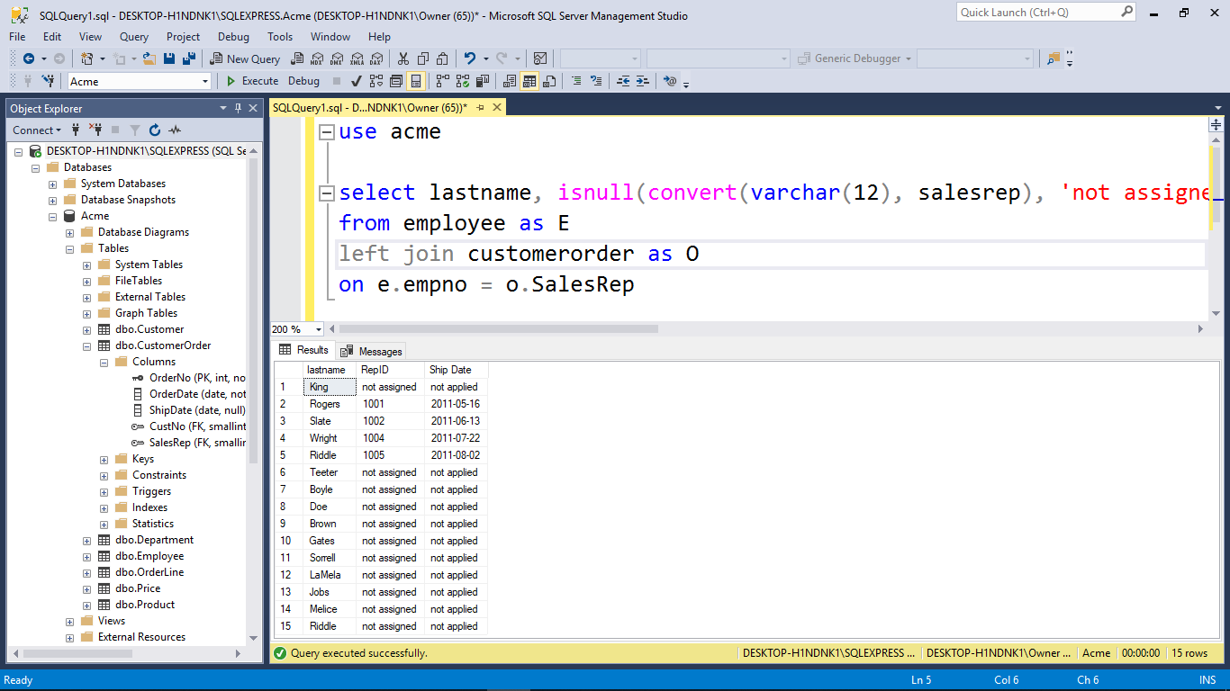

Slide 22
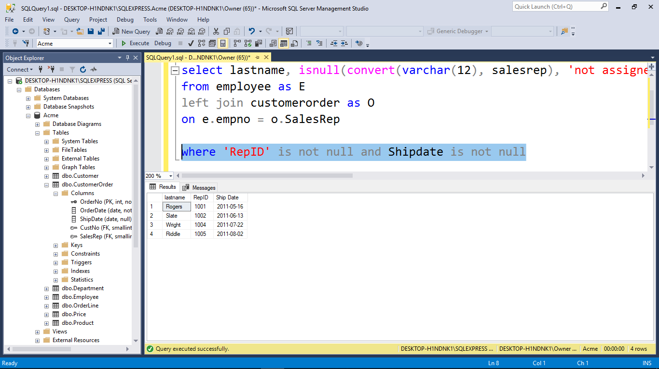
Kind of dumb.
Because this is just like a JOIN.
Don’t bother with Left.

